Slide 1

Final Report Guide Robot
ISE Capstone Design
Tamang Sanjib

Slide 2
Contents
Introduction
Project Objective
Approach to the project
Procedure
Team meeting and discussion
Demo video and implementation
Roles and contributions

Slide 3
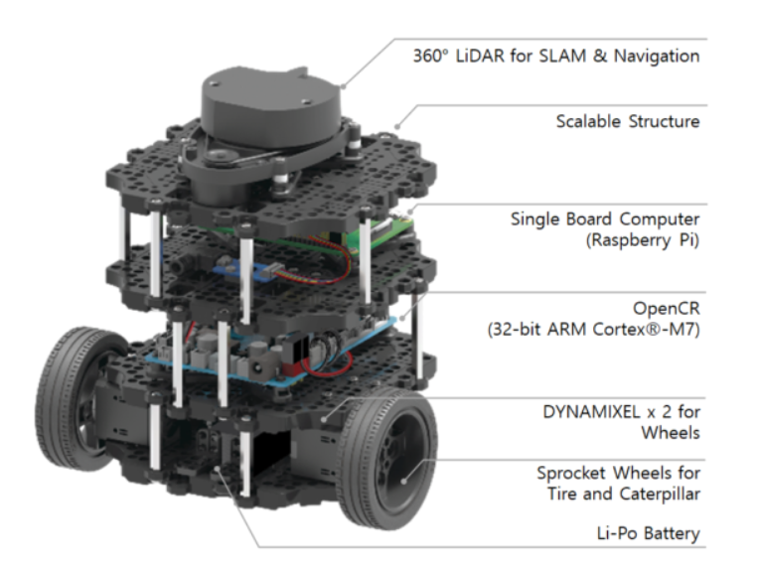
Introduction
A modern mobile robot that is modular, portable, and adaptable is the TurtleBot3 Burger.
Major Sensors and Actuators used are shown aside in the image.

Slide 4
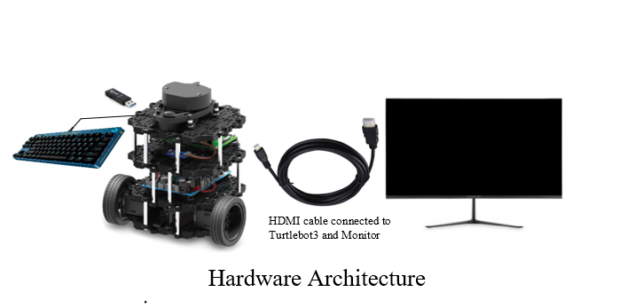
Hardware Architecture

Slide 5
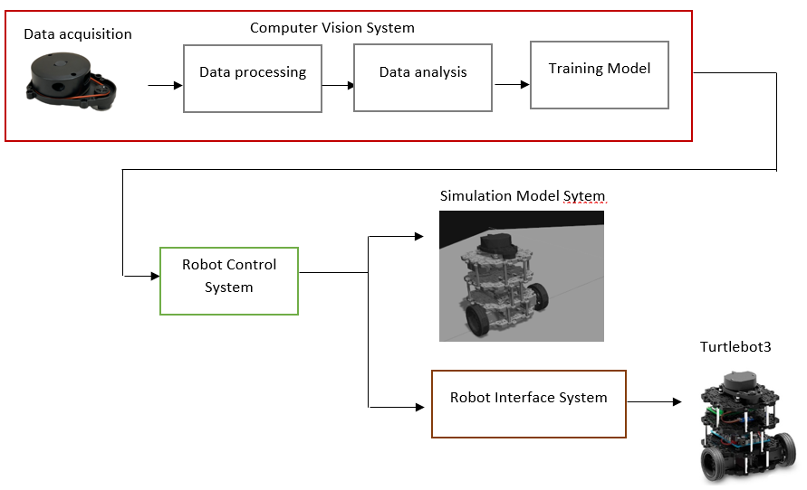
System
Structure
Overview
reference : https://www.researchgate.net/publication/335505212_Vision_Based_Control_for_Industrial_Robots

Slide 6
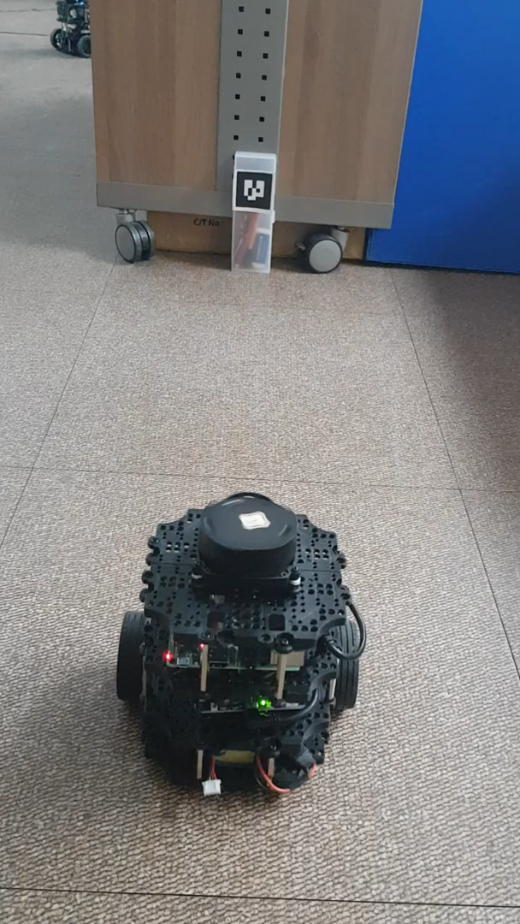
Project Objective / Proposal
The major goal of the project is to enable the Turtlebot3 to operate in autonomous driving mode that includes obstacle recognition, and traffic sign detection using ROS.

Slide 7
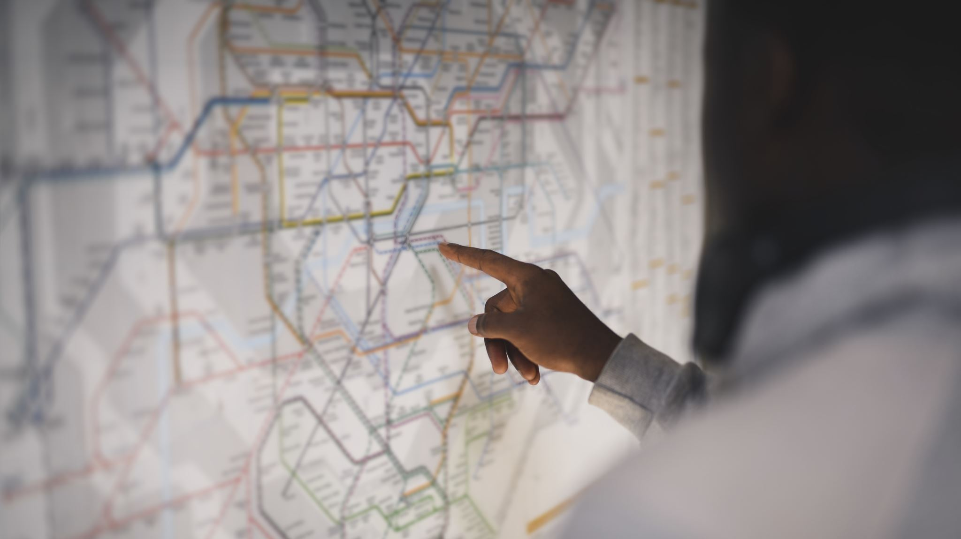
Approach to the project

Slide 8

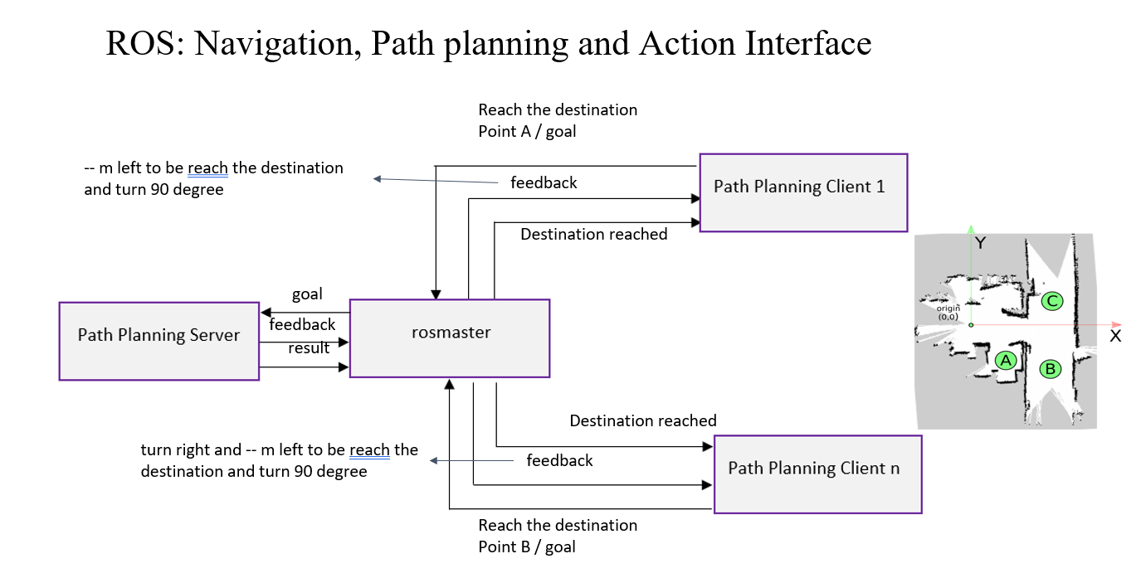
reference : https://wiki.nps.edu/pages/viewpage.action?pageId=1157791916

Slide 9
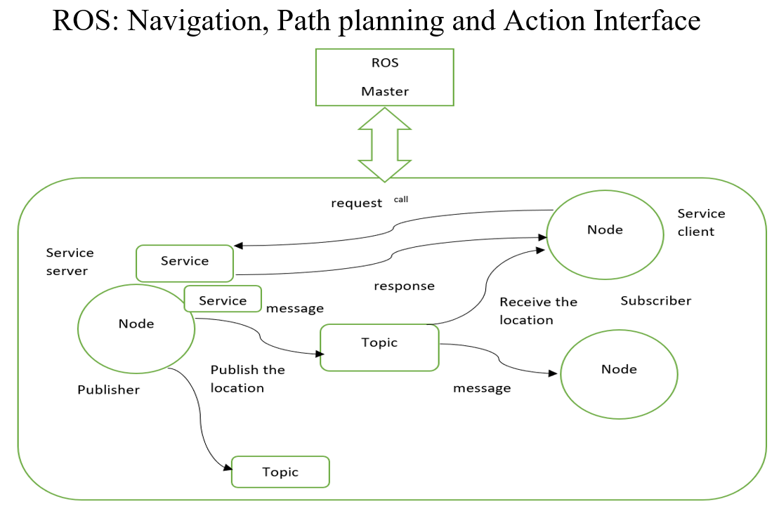
reference : http://akihikoy.net/notes/?text%2FROS%2FMinOverview

Slide 10
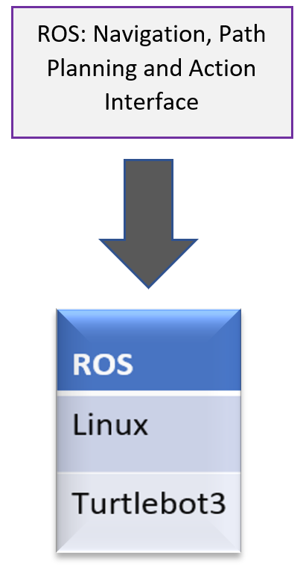
Experiment environment

Slide 11
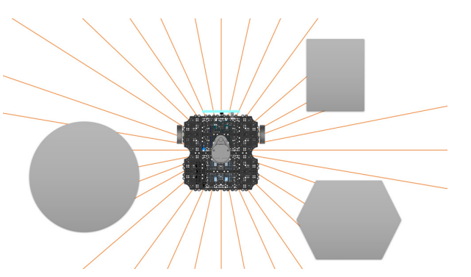
Utilizing LDS
SLAM (Simultaneous Localization And Mapping) is one of the most well-known applications of LDS. SLAM constructs a map by identifying barriers around the robot and estimating the robot's present position within the map as demonstrated in figure.
Obstacle detection of a robot using LDS

Slide 12
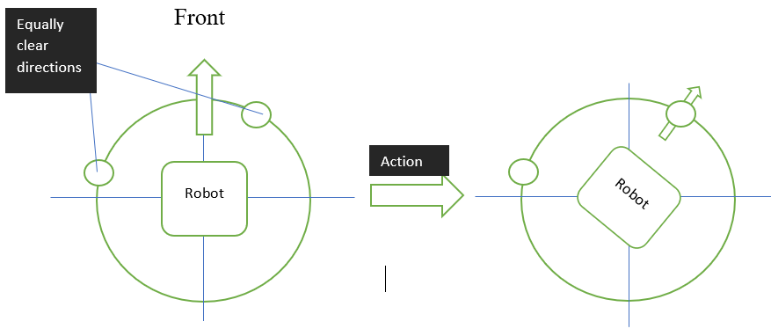
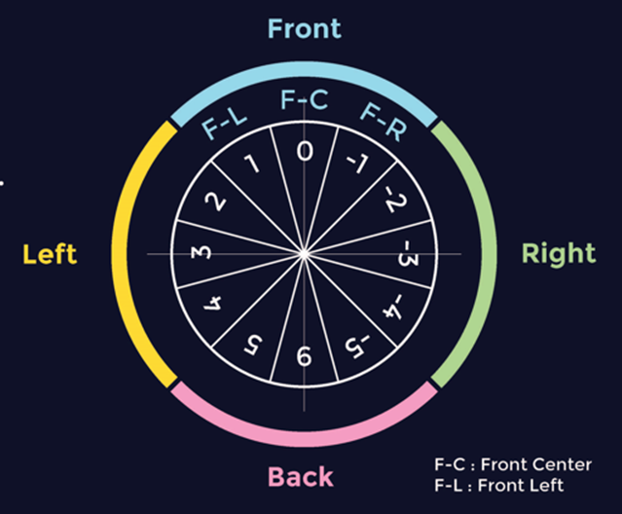
Utilizing LDS
Goal
Position the robot's front such that it faces the path that is the cleanest and produces the fewest detours.
Data processing
LiDAR technology offers 360-degree coverage. Four global areas made up of three local regions each make up the covered circle.
Each sub-integers region's represent the weight of the goal deviance (F-C). Each integer's sign specifies the robot's orientation with respect to the target (F-C).

Slide 13
Flow-chart of obstacle detection by Lidar sensor
START
INPUT (emits radiation by Lidar sensor)
Receive the information
Data processing
Detection of obstacle
yes
No
Change the path
(left,right or backwards)
Follow the same path
reference : https://www.irjet.net/archives/V4/i2/IRJET-V4I2177.pdf

Slide 14
Proposed Traffic Light System Architecture
Turtlebot3
Raspberry pi camera
Raspberry pi 4
Program development using ROS
Red LEDs Yellow LEDs Green LEDs
Monitor
Keyboard
reference : https://www.researchgate.net/publication/359756848_Raspberry_Pi-Based_Intelligent_Traffic_Signal_Control_at_Intersections

Slide 15
traffic sign detection architecture
ROS
image acquisition ROS node
robot action detection ROS node
openCR
rosserial
camera
image processing ip
Robot control (velocity,angle)
image
motor
traffic light detection

Slide 16
Procedure
Installation of PC, SBC and OpenCR Setup of Turtlebot3
Run Nodes
Camera sensor installation
Autonomous Driving
Traffic Sign Detection
Obstacle Detection

Slide 17
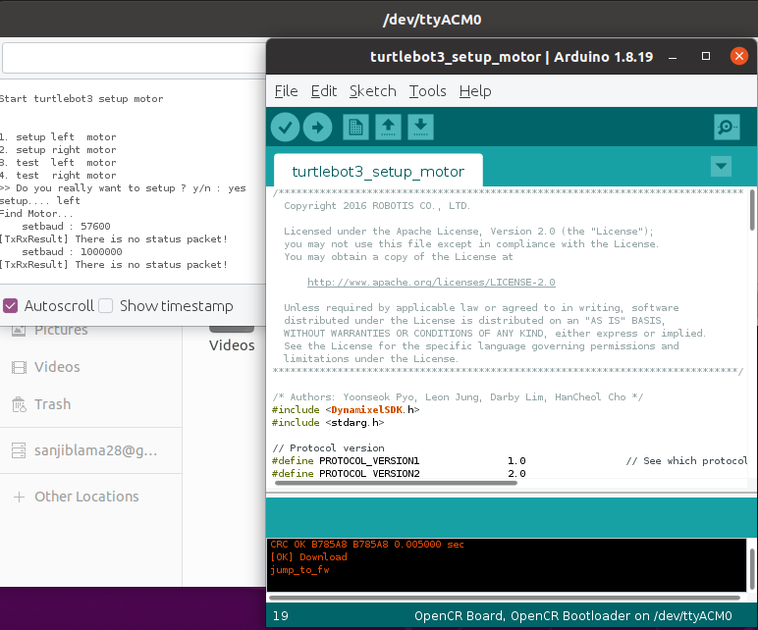
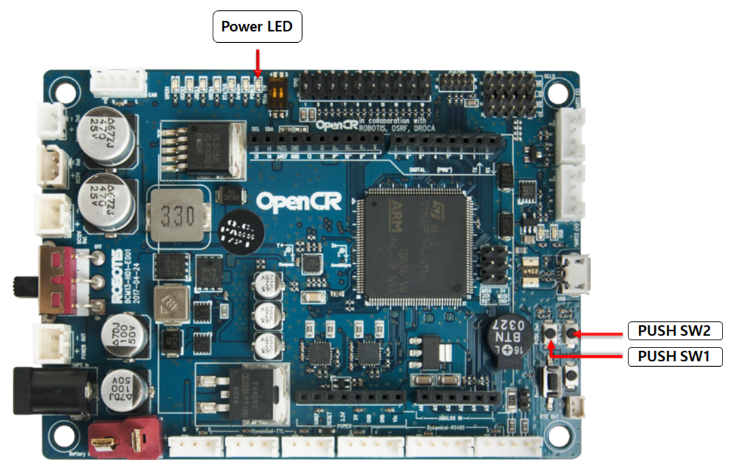
Errors
Open CR Test
Setup DYNAMIXELs for TurtleBot3

Slide 18
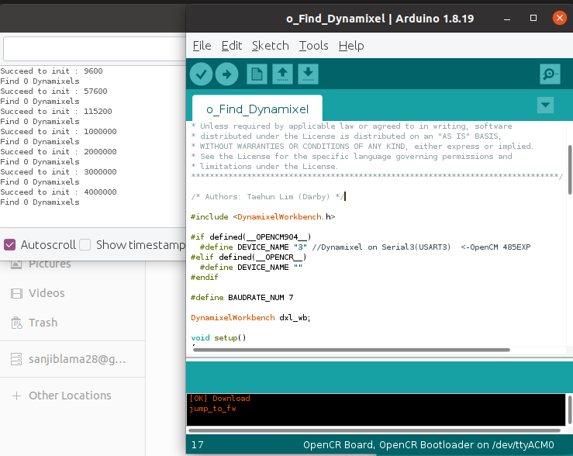
Errors
Open CR Test
o_Find_Dynamixel

Slide 19
Errors
Dynamixel Quick Guide for ROS 2

Slide 20
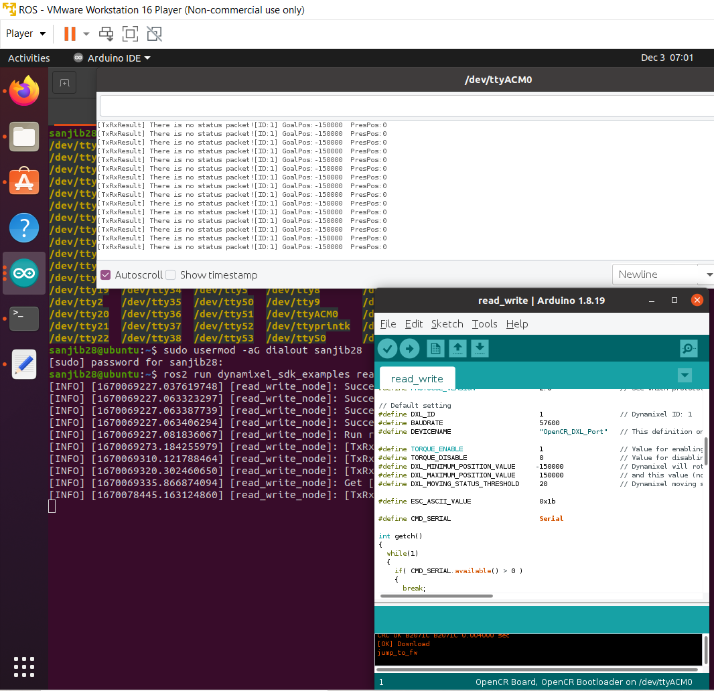
Errors

Slide 21
Experimental
setup of PC
 | Description
CPU | i7-12700
GPU | GTX 1650 ti
CUDA version | 11.6
CUDNN version | 8.5
TensorFlow version | 2.10.0

Slide 22
Experimental setup of turtlebot3
 | Description
Controller | Open CR
Interfaces | Raspberry PI
GPU | 32-bit ARM Cortex®-M7 with FPU
Sensors | LDS-01 /LDS-02
Motors | DYNAMIXEL (XL430-W250-T)/ (XM430-W210-T)
Camera
Remote Controllers | BT-410/RC-100B
IMU | Gyroscope 3 Axis Accelerometer 3 Axis

Slide 23
Project implementation
GitHub link:

Slide 24
THANK YOU

